Slide 1

BEE PROJECT
DISTANCE INDICATOR
Section: IT - A
Vijay Guttula (23911A1225)

Slide 2
DISTANCE INDICATOR
Components and Devices Used:
Arduino UNO SMD Board
Breadboard
Servo Motor SG90
Ultrasonic Sensor
5V Buzzer
LED Bulbs (7)
1KΩ Resistors (7)
Jumper Cables (16)

Slide 3
DISTANCE INDICATOR
Arduino UNO SMD Board
The Arduino UNO Board is a microcontroller board based on the ATmega328P.
It has 14 digital input/output pins (of which 6 can be used as PWM outputs), 6 analog inputs, a 16 MHz ceramic resonator, a USB connection, a power jack, an ICSP header and a reset button.
Advantages of using an Arduino UNO Board:
It is relatively inexpensive.
It is easy to use and has a large community of support.
It is versatile and can be used to create a wide variety of projects.
It is open source, which means that the software and hardware are freely available for anyone to use and modify.

Slide 4
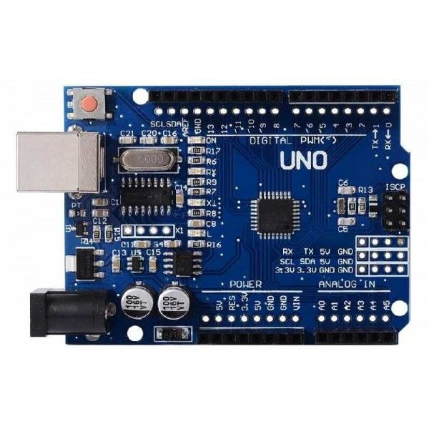
DISTANCE INDICATOR
Arduino UNO Board
17
8
15
1 - Power USB
2 - Power (Barrel Jack)
3 - Voltage Regulator
4 - Crystal Oscillator
5 - Reset
Pins (6 - 3.3, 7 - 5,
8 - GND, 9 - Vin)
10 - Analog Pins
11 - Main Microcontroller
12 - ICSP Pin
13 - Power LED Indicator
14 - TX and RX LED’s
15 - Digital I/O
16 - AREF
17 - Reset
4
16
13
11
1
14
12
3
2
6
10
9
5
8
7

Slide 5
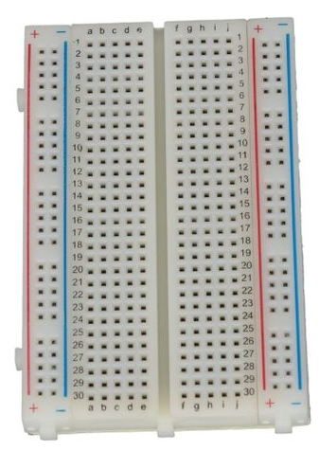
DISTANCE INDICATOR
Breadboard
A breadboard is a rectangular plastic board with a bunch of tiny holes in it. These holes let you easily insert electronic components to prototype an electronic circuit. Breadboards are great for beginners who are new to electronics. You can use breadboards to make all sorts of fun electronics projects. Unlike PCB’s, breadboards do not require soldering or destruction of tracks and are hence reusable.

Slide 6
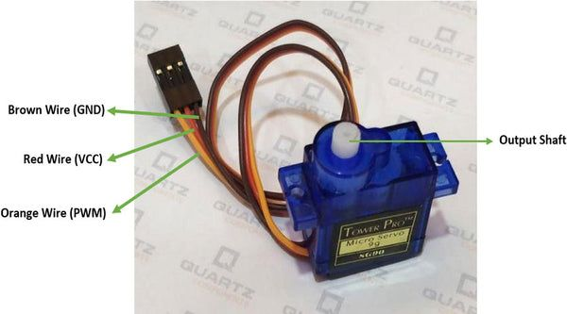
DISTANCE INDICATOR
Servo Motor SG90
The SG90 servo motor is a popular and inexpensive micro servo motor in a compact package, ideal for many small projects. This micro servo is very easy to use for beginners, with no need for a dedicated servo-drive board with feedback control and a complicated gearbox.
To use the SG90 servo motor, you can connect it to a microcontroller or a dedicated servo driver board. The connections are as follows:
Red wire: 5V
Brown wire: Ground
Yellow wire: Digital pin 9 (or any other digital pin)

Slide 7
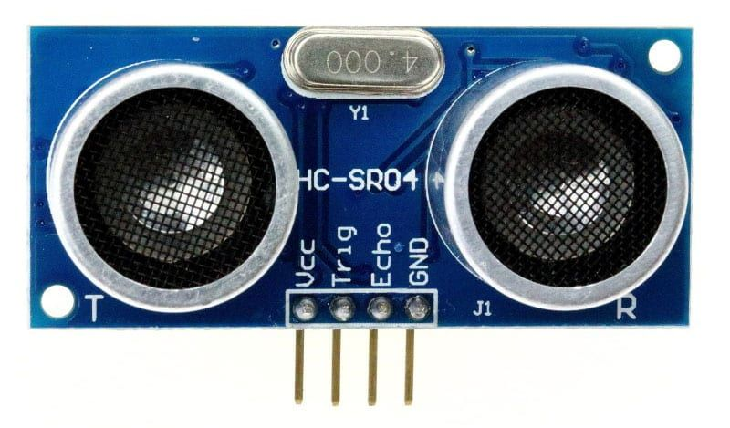
DISTANCE INDICATOR
Ultrasonic Sensor HC-SR04
The HC-SR04 ultrasonic sensor is a popular choice for measuring distance in various applications, including robotics, automation, and IoT projects. It works by sending out an ultrasonic burst and measuring the time it takes for the sound wave to bounce back from an object.
The HC-SR04 module has four pins:
VCC (Power): Connect to the Arduino’s 5V pin
Trig (Trigger): Connect to any digital pin on the Arduino (e.g., pin 2)
Echo (Receive): Connect to any digital pin on the Arduino (e.g., pin 3)
GND (Ground): Connect to the Arduino’s GND pin

Slide 8
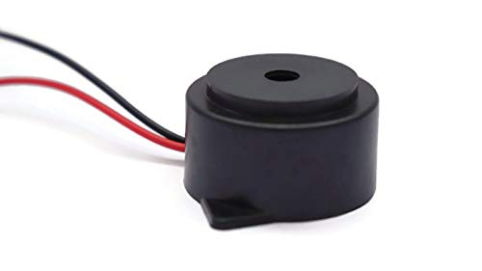
DISTANCE INDICATOR
5V Buzzer
A 5V buzzer is a small, inexpensive electronic device that can generate sound. It is commonly used in Arduino projects to provide audible feedback or alerts.
5V buzzers are typically very small and lightweight, making them easy to use in Arduino projects. They are also very inexpensive, often costing less than $1/70 INR.
To use a 5V buzzer with an Arduino, you will need to connect it to one of the Arduino's digital pins. You will also need to write a sketch that tells the Arduino when to turn the buzzer on and off.

Slide 9
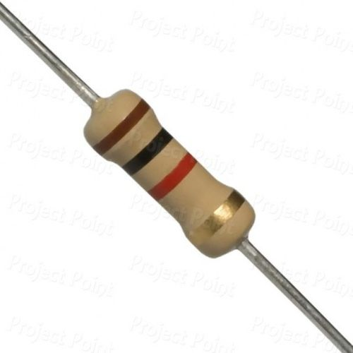
DISTANCE INDICATOR
1KΩ Ohm Resistor
A 1000 ohm resistor, also known as a 1k ohm resistor, is a common value of resistor used in various electronic circuits. Its purpose can vary depending on the specific application, but here are some general uses:
Voltage Division
Current Limiting

Slide 10
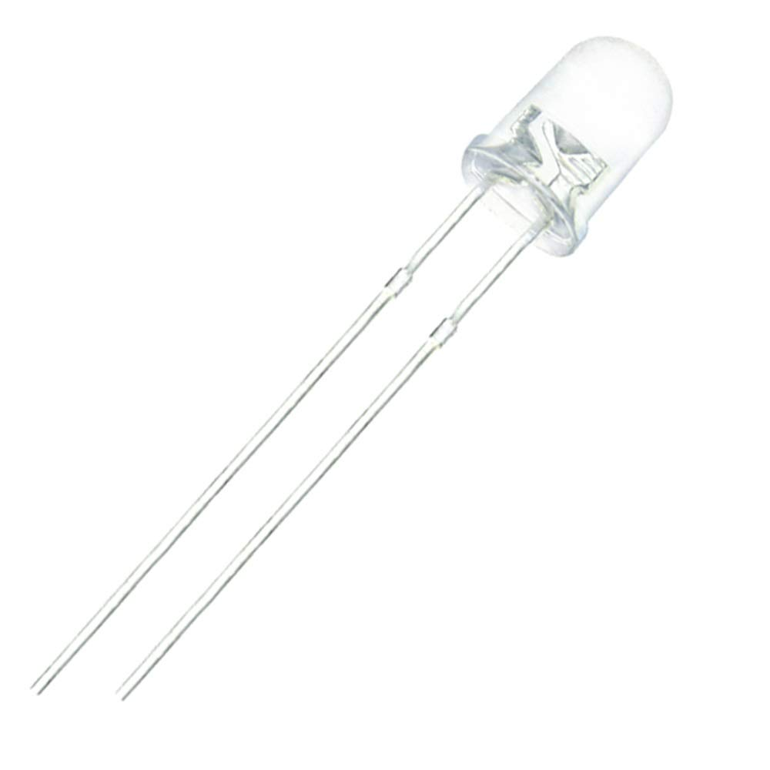
SMART FLOOD SENSOR
LED Bulb
An LED bulb can be used with an Arduino to create a variety of projects, such as a simple night light or a more complex lighting system. To use an LED bulb with an Arduino, you will need to connect the bulb to an Arduino digital pin and GND pin.

Slide 11
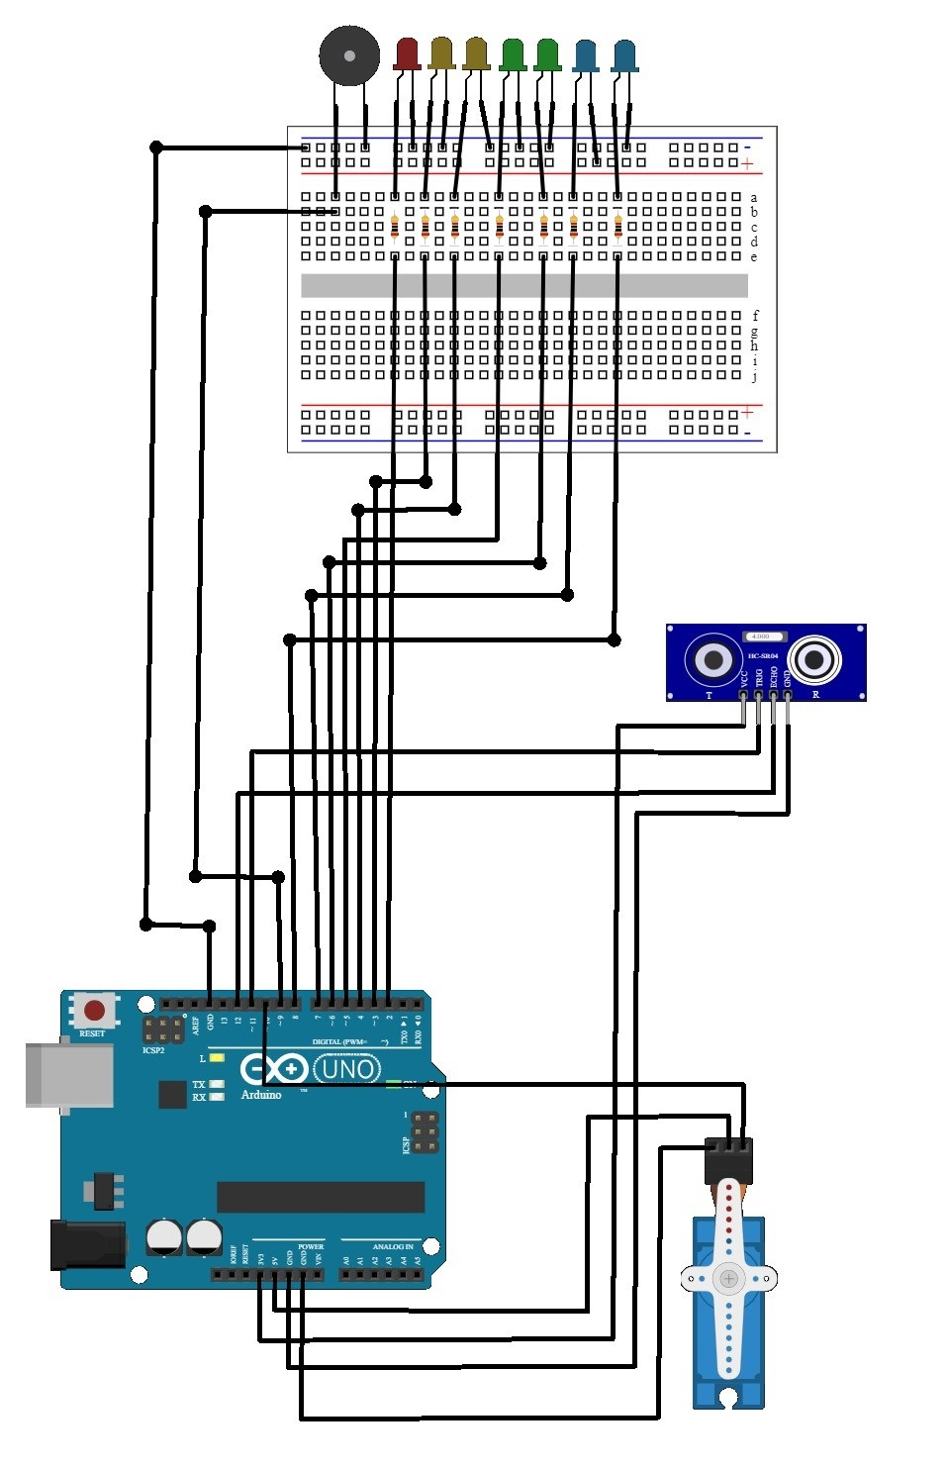
DISTANCE INDICATOR
Circuit Diagram:
LED’s
Buzzer
Breadboard
HC-SR04 Ultrasonic Sensor
Arduino UNO SMD Board
Servo Motor SG90

Slide 12
DISTANCE INDICATOR
Working of Distance Indicator:
When the Arduino gets power input, the ultrasonic sensor sends an ultrasonic pulse and measures the time for the echo to return. This time is used the distance to an object.
The servo motor’s position is adjusted based on the measured distance, with the angle being mapped proportionally to the distance.
LEDs are used to indicate different ranges, and a buzzer is activated if the distance is less than or equal to 30 cm, providing additional feedback on the proximity of objects.

Slide 13
DISTANCE INDICATOR
Advantages:
The setup can be used for practical applications like obstacle detection and avoidance, which are essential in robotics and automation systems.
It can serve as a foundation for more complex projects, such as automated car parking systems or home security systems.
The project includes interactive elements like LEDs, a buzzer, and a servo motor, making it engaging and providing immediate feedback on the system's status and performance.

Slide 14
DISTANCE INDICATOR
Disadvantages:
The sensor's accuracy can be affected by environmental factors such as temperature, humidity, and the surface material of the object being detected.
The project might require a stable power source, especially if additional components are added. Battery-powered setups might need frequent recharging or replacement.
Ultrasonic sensors can have blind spots where objects are not detected properly, particularly very close objects.

Slide 15
DISTANCE INDICATOR
Applications:
Obstacle Detection and Avoidance
Automated Parking Systems
Distance Measurement Tools
Home Security Systems
Level Sensing
Interactive Art Installations
Automated Doors
Proximity Alerts
Factory Automation
Agricultural Automation

Slide 16
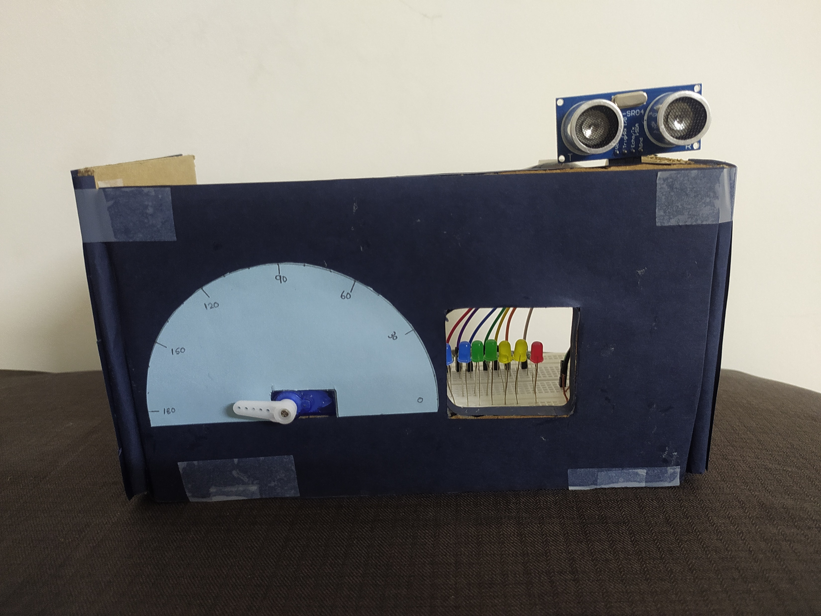
DISTANCE INDICATOR
Model:

Slide 17
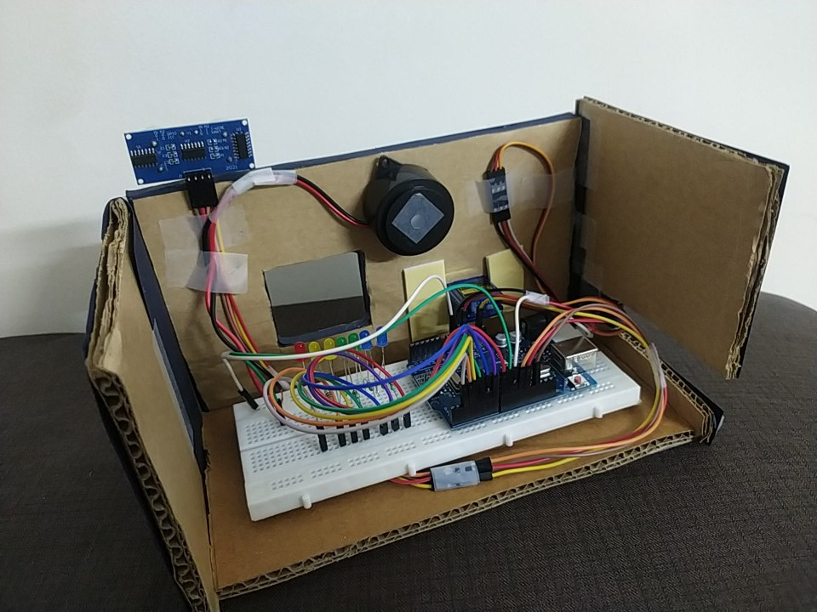
DISTANCE INDICATOR
Model:

Slide 18
THANK YOU
DISTANCE INDICATOR

